Slide 1

A comparative study of analog vs digital image acquisition, using structured visuals and examples.
COURSE CODE:ITA0518-COMPUTER VISION
PRESENTED BY
K.ASWINI(192312397)-ECE
Guided by
Dr.T.M.USHA

Slide 2


Introduction
Image acquisition is the process of capturing a real-world scene and converting it into a form that can be processed by a system.
It is the first and most important step in image processing and computer vision.
Image acquisition can be performed using two main approaches: analog and digital.
In analog image acquisition, the image is captured as a continuous signal without any discrete representation.
In contrast, digital image acquisition converts the image into discrete pixel values using sampling and quantization, making it suitable for storage, processing, and analysis.
Understanding the difference between analog and digital image acquisition is essential for designing efficient imaging systems and improving image quality.
Notes:
Image source: https://ae01.alicdn.com

Slide 3
DIGITAL IMAGE ACQUISITION
Digital image acquisition is the process of capturing a real-world scene and converting it into a digital format that can be processed by computers.
It begins with a sensor, such as a CCD or CMOS camera, which captures light and converts it into an electrical signal.
This signal is then passed through an Analog-to-Digital Converter (ADC), where it is transformed into discrete numerical values.
The process involves two important steps: sampling, which divides the image into pixels, and quantization, which assigns intensity values to each pixel.
The final output is a digital image composed of a grid of pixels, making it easy to store, analyze, and use in applications such as computer vision, medical imaging, and surveillance systems.
Notes:
Image source: https://www.build-electronic-circuits.com

Slide 4
ANALOG IMAGE ACQUISITION
Analog image acquisition is the process of capturing a real-world scene in the form of a continuous signal without converting it into discrete values.
In this method, light from the scene is sensed and directly transformed into an electrical signal that varies smoothly with intensity.
Unlike digital systems, analog acquisition does not involve sampling or quantization, so the image information remains continuous.
This results in smooth intensity variations but makes storage, processing, and analysis more difficult.
Analog image acquisition was commonly used in older systems such as film cameras and traditional CCTV cameras, and it forms the basic foundation for modern digital imaging systems.

Slide 5
KEY DIFFERENCE
Analog and digital image acquisition differ mainly in the way images are represented and processed.
In analog image acquisition, the image is captured as a continuous signal with smooth variations in intensity, making it difficult to store and process due to the influence of noise and lack of discrete structure.
In contrast, digital image acquisition converts the image into discrete pixel values through sampling and quantization, allowing easy storage, efficient processing, and accurate analysis using computers.
While analog systems were commonly used in older imaging technologies, digital systems are widely preferred today due to their flexibility, reliability, and compatibility with modern applications such as computer vision and image processing.
Notes:
Image source: https://thumbs.dreamstime.com

Slide 6

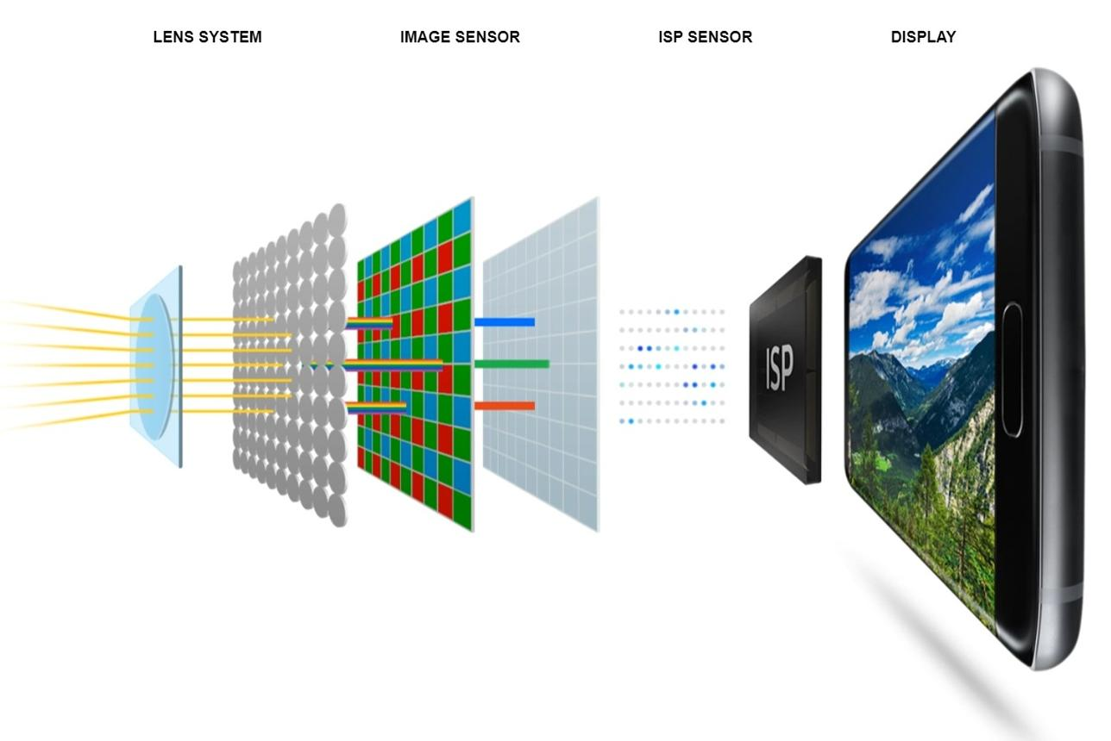
Analog image aquisition
Examples
Digital image aquisition

Slide 7
KEY STEPS OF IMAGE ACQUISITION
The process of image acquisition involves several important steps that convert a real-world scene into a usable image.
First, the scene is captured using a sensor such as a camera, where light energy is converted into an electrical signal.
In analog systems, this signal remains continuous, while in digital systems it is further processed.
The next step is sampling, where the continuous image is divided into a grid of pixels, determining the spatial resolution.
This is followed by quantization, where each pixel is assigned a discrete intensity value, defining the brightness levels. Finally, the processed data is stored as a digital image, which can be easily displayed, analyzed, and used for further image processing applications
Notes:
Image source: https://www.slidemake.com

Slide 8
APPLICATIONS
Image acquisition plays a vital role in many real-world applications by enabling machines to capture and analyze visual information.
It is widely used in computer vision systems for tasks such as object detection, facial recognition, and autonomous driving.
In medical imaging, it helps in capturing images like X-rays, MRI, and CT scans for diagnosis and treatment.
Image acquisition is also essential in surveillance systems for monitoring and security purposes.
Additionally, it is used in remote sensing to capture satellite images for weather forecasting, agriculture, and environmental monitoring. These applications highlight the importance of image acquisition in both analog and digital domains for efficient data analysis and decision-making.
Notes:
Image source: https://teachingwriting.stanford.edu

Slide 9
Accuracy control
Accuracy control in image acquisition refers to how precisely the captured image represents the original real-world scene.
In analog image acquisition, accuracy is difficult to control because the continuous signal is highly affected by noise, distortion, and environmental conditions, which can degrade image quality.
In contrast, digital image acquisition offers better accuracy control through parameters such as spatial resolution (number of pixels) and intensity resolution (number of gray levels).
By adjusting sampling and quantization levels, digital systems can achieve higher precision, consistency, and reliability, making them more suitable for modern image processing and analysis applications.
Notes:
Image source: https://img.electronicdesign.com

Slide 10
CONCLUSION
In conclusion, image acquisition is a fundamental step in image processing that enables the capture of real-world scenes for analysis and interpretation.
While analog image acquisition represents images as continuous signals, digital image acquisition converts them into discrete pixel values, making processing, storage, and analysis much more efficient.
With advancements in technology, digital methods have become dominant due to their accuracy, flexibility, and compatibility with modern applications such as computer vision, medical imaging, and surveillance systems.
Understanding both approaches helps in designing better imaging systems and improving overall image quality.
Notes:
Image source: https://i1.wp.com

Slide 11
CHALLENGES AND FUTURE WORKS
Image acquisition faces several challenges that affect the quality and efficiency of captured images. One major challenge is noise and distortion, especially in analog systems, which can degrade image clarity. In digital image acquisition, issues such as limited resolution, quantization errors, and sensor limitations can impact accuracy.
Future work in image acquisition focuses on improving sensor technology, such as developing high-resolution and low-noise CMOS sensors. Advanced techniques like artificial intelligence and deep learning are being integrated to enhance image quality, reduce noise, and improve feature extraction.

Slide 12
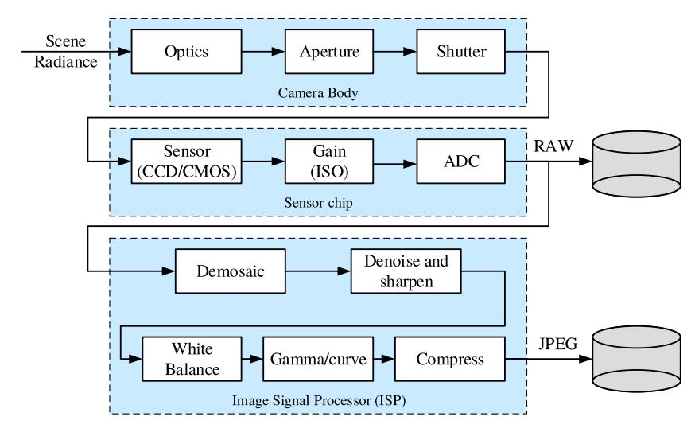
BLOCK DIAGRAM

Slide 13
Thank you!!!

